Slide 1
Maneuvering Through the Regulatory Process: Permitting, Compliance and Enforcement
Presenters:
Anna H. Long
Dean, Mead, Egerton, Bloodworth, Capouano, & Bozarth, P.A.
Amanda Brock
Henderson, Franklin, Starnes & Holt, P.A.
Douglas M. Halsey
White & Case
Peter K. Partlow, PE
E Sciences, Incorporated

Slide 2
Amanda L. Brock, Esq.
Amanda Brock is a Shareholder with the Fort Myers office of the Henderson Franklin law firm. She concentrates her practice in land use and environmental law, and routinely handles matters involving environmental compliance, zoning, development approvals, and hazardous waste site remediation. She represents clients before local, state and federal agencies. While in law school at Florida State, she served as Editor-In-Chief of the Journal of Land Use and Environmental Law. Amanda is a member of the Executive Council of the Environmental and Land Use Law Section of the Florida Bar, chairing its Land Use committee, on the Lee County Conservation Land Acquisition and Stewardship Advisory Committee, and is Co-Chair of the Land Use and Governmental Law Section of the Lee County Bar Association.
As part of her practice, she lectures on a broad variety of topics, including: Regulation and Cleanup of Contaminated Properties; Engineering, Legal and Political Aspects of Brownfields Redevelopment and Site Closure in the City of Fort Myers; How to Deal with Agencies in Negotiating Agreements; and Environmental Site Contamination Detection & Remediation.

Slide 3
Anna Long, Esq.
Anna Long is an attorney with the firm of Dean, Mead, Egerton, Bloodworth, Capouano & Bozarth, P.A. in Orlando, and has a broad background in environmental law, land use and zoning, and administrative law. Anna has over thirty years of experience in environmental law and environmental management. Prior to moving into private practice, Anna served as the manager for the Orange County Environmental Protection Division of Orange County, Florida for over five years. Anna also held numerous environmental managerial positions in various business industries including Director of Environment, Safety & Health for the largest semi-conductor company in the northwest and manager of the environmental division of a major private electric utility company, as well as General Counsel and Director of Environmental Services for a multi-state environmental and engineering and consulting firm.
Anna also received a Certificate in Natural Resources from Lewis & Clark’s Northwestern School of Law. Anna is licensed to practice law in Florida, as well as Oregon and the State of Washington.

Slide 4
Douglas M. Halsey
WHITE & CASE
Head of White & Case's Environmental Practice Group, Doug advises clients on all aspects of environmental and land use law, including litigation, transactional advice and regulatory matters. He has represented manufacturers, developers, and property owners in complex civil litigation and defended enforcement actions brought by federal, state, and local government agencies. He has experience litigating under the Clean Water Act, CERCLA, RCRA, CAA, NEPA, and parallel state and local government regulatory schemes. In 2003, following 11 years of litigation in federal and state courts, Doug obtained for property owners in Monroe County, Florida, the largest recovery in US history for a "temporary taking.“ He has also defended numerous toxic tort cases based on alleged exposure to a variety of hazardous substances, including creosote, chlorinated solvents and mercury.
Doug represents industrial and developer clients before environmental agencies on regulatory and permitting matters on a local, state and national level. His many years of experience include representing the largest solid waste company in the United States, as well as coordinating wetlands and endangered species permitting and complex land use matters in environmentally sensitive areas in Florida and other jurisdictions.
Doug also advises on environmental risks associated with business transactions. He is frequently called upon to work with the Firm's corporate partners in multibillion-dollar acquisitions, financings, stock and bond offerings and real estate deals both domestically and internationally. He frequently lectures on various environment and land-use topics. The former chairman of the Environmental and Land Use Law Section of the Florida Bar, he has been recognized by the Florida Bar for his pro bono work for children in foster care.

Slide 5
Peter K. Partlow, PE
Peter is co-founder, President and Principal Engineer of E Sciences, Incorporated in Orlando, Florida. E Sciences provides a wide range of environmental and ecological engineering professional consulting services to public and private clients. Mr. Partlow has over 20 years of environmental engineering experience in the areas of Project Management and Oversight in addition to Quality Assurance and Control. His technical expertise and project experience are in the areas of mitigation banking and hydrologic restoration; contamination assessment and remediation; water resources and quality; development feasibility analysis; and major project administration for municipal and industrial clients.
During his career, he has managed the research, analysis and documentation necessary for environmental projects of all types, including providing support for environmental assessments and environmental impact statements as appropriate to satisfy the requirements of the National Environmental Policy Act (NEPA) and/or other related Federal and State environmental laws and regulations.

Slide 6
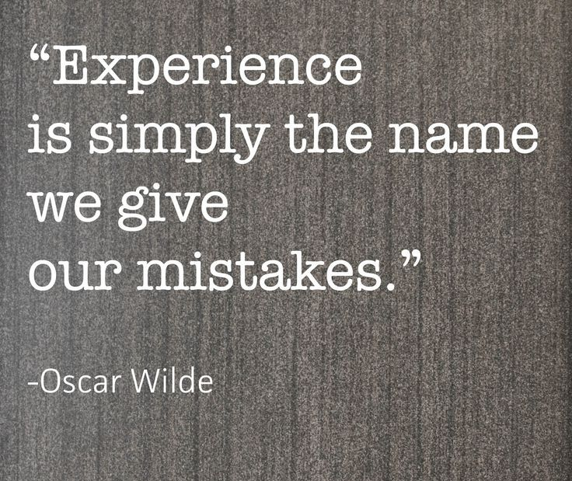
Practical Solutions
Common Sense Oriented
Based on Experience

Slide 7
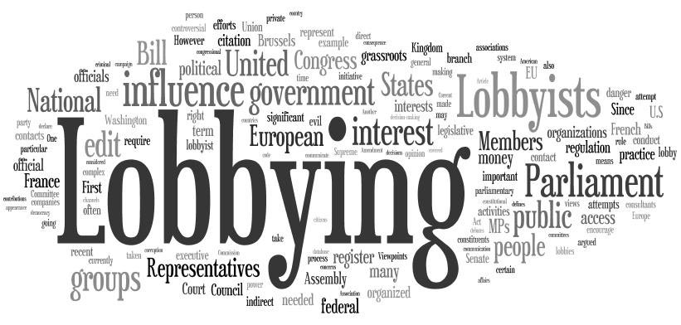
Lobbying
Regulations
Restrictions on Lawyers

Slide 8
Lobbying Regulations
Environmental advocacy before state and local government agencies – Is it “lobbying” that requires registration and disclosure?
Florida has 67 counties and 481 cities, many of which have lobbying registration requirements.
Annual lobbyist registration fees range from $25 (Palm Beach County) to $525 (City of Miami).

Slide 9
Lobbying Regulations
Definition of “lobbying” varies considerably:
Palm Beach County – focus is on activities regarding an item that may be presented to the County Commission or a municipal governing body.
Miami-Dade County – attempting to influence the decision of any county personnel.

Slide 10
Lobbying Regulations
Important to check local government regulations on lobbying and lobbyist registration and determine how those regulations are being interpreted and enforced.
Overbroad lobbying regulations are sometimes so onerous that they are not consistently enforced.

Slide 11
Lobbying Regulations
Lobbying regulations apply to everyone, principals as well as agents. Engineers, geologists, planners, and other professionals representing a client fall within most definitions of lobbyist.

Slide 12
Restrictions on Lawyers
When there is litigation between a governmental agency and a regulated party, the lawyer for the regulated party may not talk to an employee of the governmental agency outside the presence of an attorney for the governmental agency.
In 2014-2015, some local government lawyers sought to broaden this prohibition to include situations where the government and regulated entity are not involved in litigation.

Slide 13
Restrictions on Lawyers
After considerable debate, the Florida Bar rejected the proposed expansion of Rule 4-4.2 of the Rules of Professional Conduct.
Though not required to do so by the Florida Bar Rules, there may be circumstances where there is no litigation, but it would be appropriate to invite a lawyer for the government to attend a meeting with staff.

Slide 14
10. Take Time to Know the Facts from Both Perspectives
There are at least two sides to every story and somewhere in between is what really happened.
Notes:
Add examples

Slide 15
Duty to Investigate
Never assume that everything you are told is the whole truth
Review any case files, meeting notes, or other information to get a clear picture
Technology is your friend: Google Earth is a great tool!

Slide 16
Picture it:

Slide 17
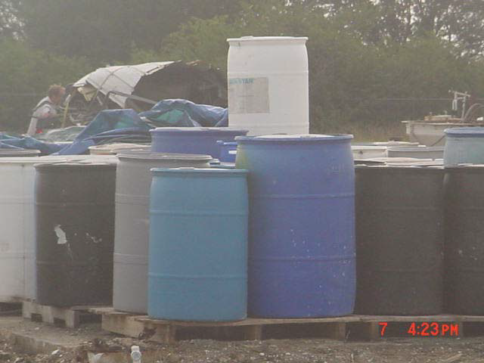
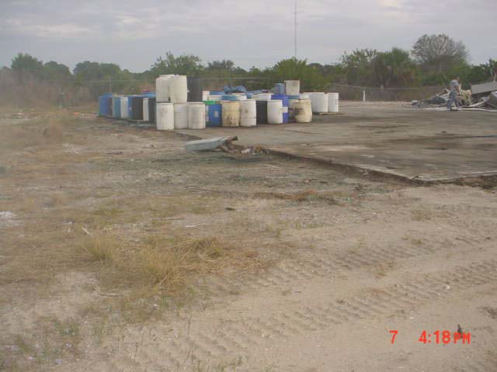

Slide 18
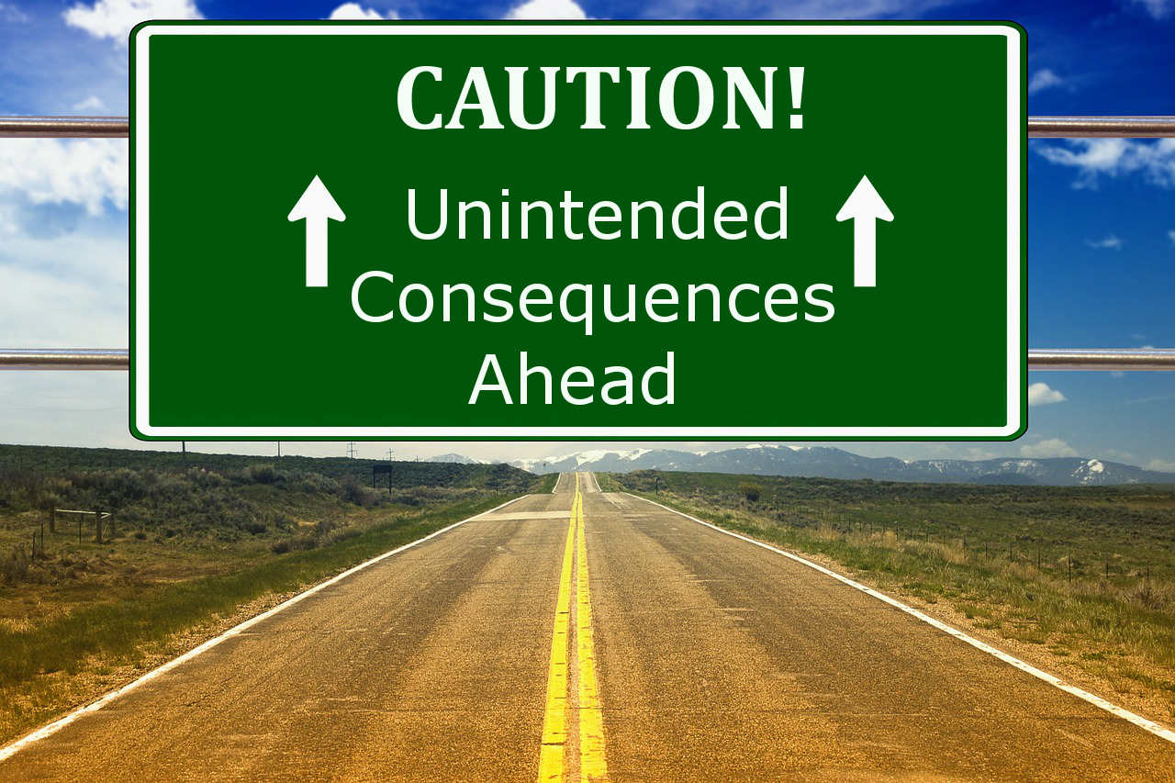
9. Do your Research
How serious is the issue?
Don’t underestimate the consequences.
What are you agreeing to?
A consent order can be very onerous

Slide 19
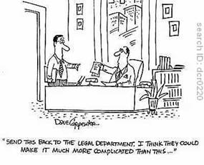
Do your Research
Understand the issue
Is it rule or guidance?
Understand the potential penalties
Understand the options

Slide 20
8. Document Everything
We wanted sunshine…we got it!
F.S. ch 286 governs Sunshine Law
F.S. ch 119 governs public records

Slide 21
Document Everything
Best to take great notes BUT if agency staff are also taking notes, think public record
Consider what to disclose or not – if it’s a confidential document, best not to share
Follow up meeting discussions / action plans in email
Keep great notes for your file – these projects tend to come around again!

Slide 22
Second Chances…
Notes:
Sunshine
Public Records
Peter Public Records issue

Slide 23
7. Know Your Audience
Who are you working with?
You need to meet – who do you want to be there?
Who are the decision makers?
Both on the agency and private side
What relationships are involved?
Bare in mind people change positions!

Slide 24
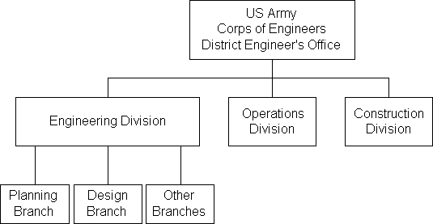
Where to Look
Agency organizational charts
Delegation of Authority
USACE, FDEP or WMD
Staff directories

Slide 25
6. Communicate PKP
Written
Document, Document, Document (this includes phone conversations, and casual meetings, as well as formal meetings).
Know statutory requirements for submitting written communications.
Dates
Content
Format
Routing

Slide 26
Communicate
Adhere to “voluntary” and/or “negotiated” terms for communicating.
Deadlines
Content
Format
Routing
Provide Updates when applicable, including notifications when dates, commitments, etc., need to be adjusted, and
Document, Document, Document

Slide 27
Communicate
Verbal
“On the record” vs. “Informal hypotheticals”
Remember that each party has a “client”
Conference calls – do you ever really know who is on the other line?
The Facts, Nothing But the Facts
Client Confidentiality vs. Duty to Provide Information
Document, Document, Document
Notes:
All to add examples
Anna – Most common is related to agency inspections
Take notes then follow up in writing
Need to be careful in communications:
NSPE Code of Ethics Professional Obligations 4 – Engineers shall not disclose, without consent, confidential information concerning the business affairs or technical processes of any present or former client or employer, or public body on which they serve.

Slide 28
5. Know the Expectations of Outcome
What does the agency need from you?
What do you want out of the meeting?
What is the level of authority of the person(s) that you are meeting with?
Can the person(s) you are meeting with approve what you need?
Any legal precedent on other sites?
Is it possible to negotiate?

Slide 29
Expectations of Outcome
Disappointment
Expectation
Outcome
Notes:
Gordon to add example

Slide 30
4. Understand Gravity of Situation and Perspective from Agency
Understand the “worst case scenario” from the beginning
Consider the agency’s perspective
Is this a repeat violation?
Is there a recent, similar case that soured the agency’s view of this type of situation?
What is the global effect of their decision in this particular case? Setting precedent often a concern.

Slide 31
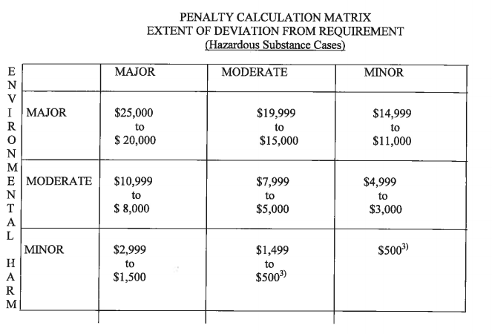
Things to Consider
Look on agency’s sites for similar cases
Search databases for specific information
Skim news releases for current related events
Penalty Matrix and Multiplier
Agencies may have the ability to multiply penalties for repeat offenders
Notes:
Peter – EPA story

Slide 32
Communicate this!

Slide 33
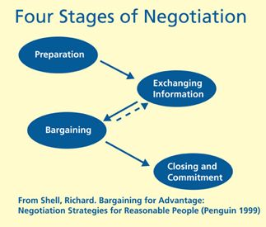
3. Have a Strategy for Resolution
Consider all options
Be prepared to give in a little
Know what you want to stand firm on
Consult lawyer?
Hire a consultant?

Slide 34
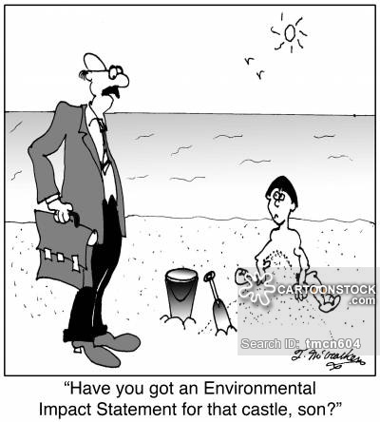
Strategy for Resolution
Understand the Regulations
Chapter 62-780 FAC – Contaminated Site Cleanup Criteria
SOPs / Guidance
Understand the Agency’s Jurisdiction
FDEP vs WMD

Slide 35
Real World Stories
Collier County — Fracking

Slide 36
Pharmaceutical Manufacturing

Slide 37
2. Always Follow Through
Crucial to maintain, among other things – credibility.
You cannot always assume “no news is good news.”
This applies not only regarding compliance matters generated as a result of a consent order or settlement agreement, but to effectuate permit transfers.

Slide 38
Follow Through — Regulations
Time periods for responses
Ch 120 F.A.C. – Administrative Procedure Act
120.57 Additional procedures for particular cases.
120.573 Mediation of disputes
120.574 Summary hearing
Ch 62-330 ERP* q3
Ch 68A-27 Rules Relating to Endangered or Threatened Species (refers to Ch 120)
Ch 62-761.450 – Underground Storage Tank Systems

Slide 39
1. Respect
Goes without saying but…
Be Polite, Courteous, RESPECTFUL even when disagreeing with opposing side
Understand that everyone has a job to do and a side to represent.

Slide 40
Respect Regulatory Authority
Sources of Law
Regulatory Agencies derive their powers from Federal, State, and Local Regulations or in some instances, the State Constitution
Local Governments (FL Const. Art. VIII, F.S. ch124 &165)
Code Enforcement (F.S. ch 162)
Growth Management (F.S. ch 163)
DEP Air/Water Pollution Control (F.S. ch 403)

Slide 41
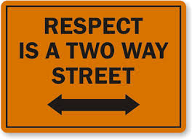
Respect In Action
Notes:
Amanda – Discussion on the Spring Training developer.

Slide 42
Amanda Brock
Henderson, Franklin, Starnes & Holt, P.A.
(239) 344-1269
amanda.brock@henlaw.com
Anna H. Long
Dean, Mead, Egerton, Bloodworth, Capouano & Bozarth, P.A.
(407) 428-5120
along@deanmead.com
Douglas M. Halsey
White & Case
(305) 995-5268
dhalsey@whitecase.com
WHITE & CASE
Peter K. Partlow, PE
E Sciences, Incorporated
(407) 481-9006
ppartlow@esciencesinc.com

